Slide 1
Neural Network
Thang Nguyen

Slide 2
Remind last lession

Slide 3
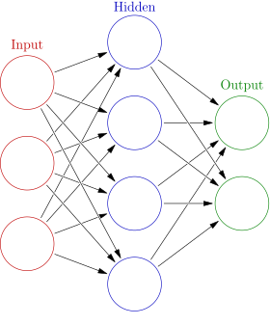
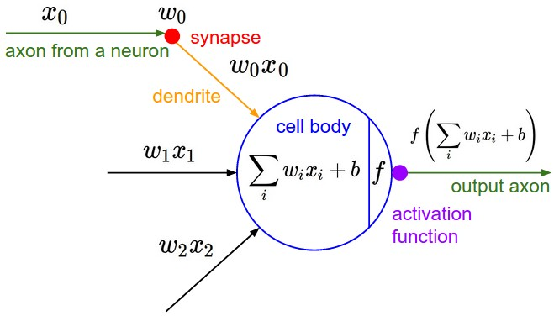
Model representation
Each node in the graph is called a neuron
Q: We know that neural network is usually used in classification tasks. But how about regression tasks?

Slide 4
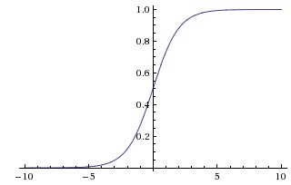
Model representation
Activation function
Problem:
Saturation
Not zero centered
Slow
Sigmoid

Slide 5
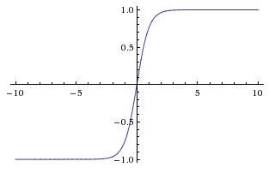
Model representation
Activation function
Always better than Sigmoid
Still having gradient saturation problem
“Tanh is a scaled sigmoid neuron”
tanh(x)=2σ(2x)−1
Tanh

Slide 6
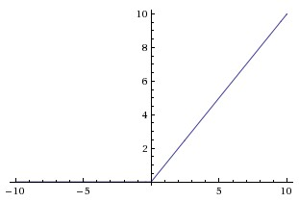
Model representation
Activation function
Most common, “default” activation function
Boost up the convergence speed
Problem: Can cause “dead neuron” problem
-> Solution: Variance of ReLU: ELU, Leaky ReLU, SELU, etc.
ReLU

Slide 7
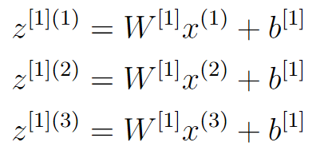
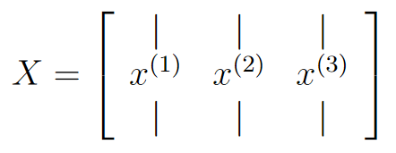
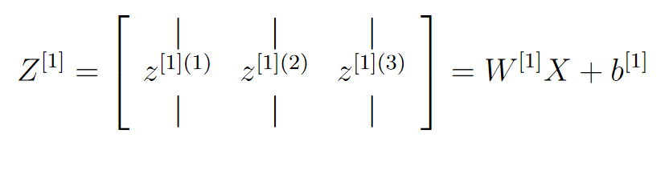
Model representation
Vecterization
For 1 layer: X is input matrix, W is weight matrix, Z is output matrix

Slide 8
Cost function

Slide 9







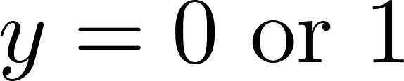
Neural Network (Classification)
total no. of layers in network
no. of units (not counting bias unit) in layer
Layer 1
Layer 2
Layer 3
Layer 4
Binary classification
1 output unit
Multi-class classification (K classes)
K output units
E.g. , , ,
pedestrian car motorcycle truck

Slide 10
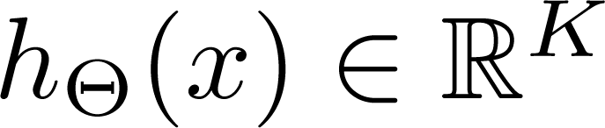
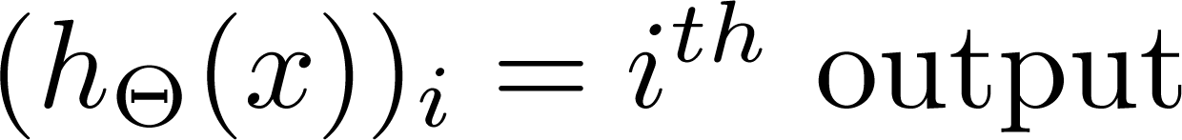
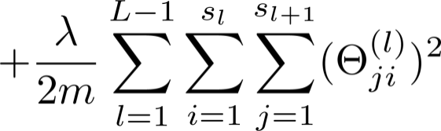
Cost function
Logistic regression:
Neural network: Cross-entropy loss

Slide 11
Backpropagation Algorithm

Slide 12
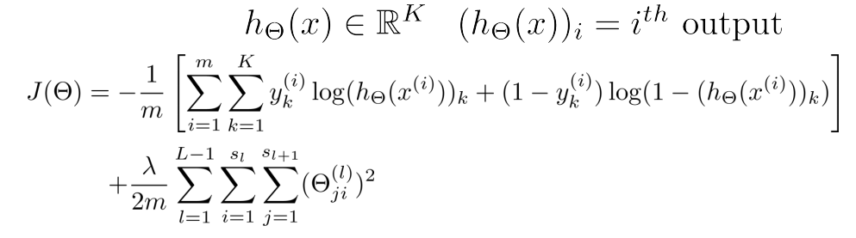

Gradient Computation
Cost Function:
Our goal: min_{Θ}J(Θ)
➔ We need compute:

Slide 13
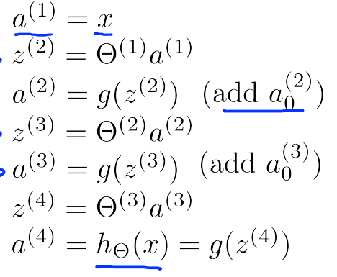
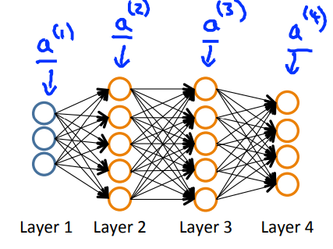
Gradient Computation: Forward propagation
Given one training example (x, y). Forward propagation:
Forward propagation:

Slide 14
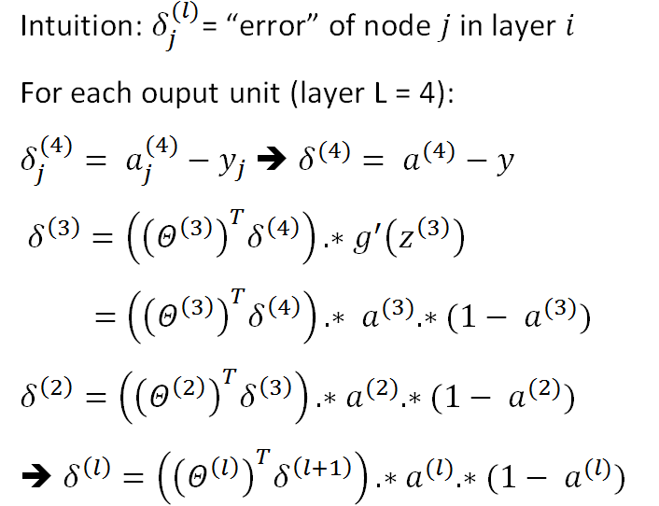
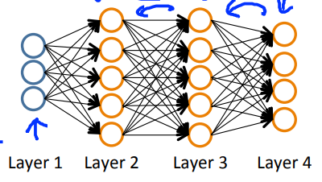
Gradient Computation: Backward propagation

Slide 15
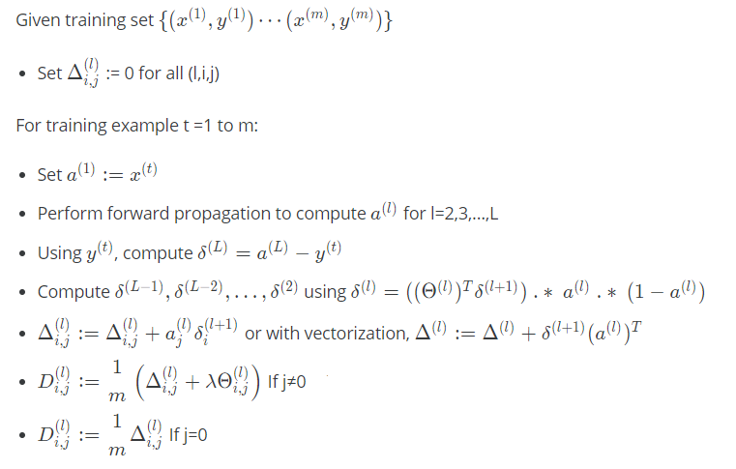

Backward propagation algorithm

Slide 16
Backpropagation Intuition

Slide 17
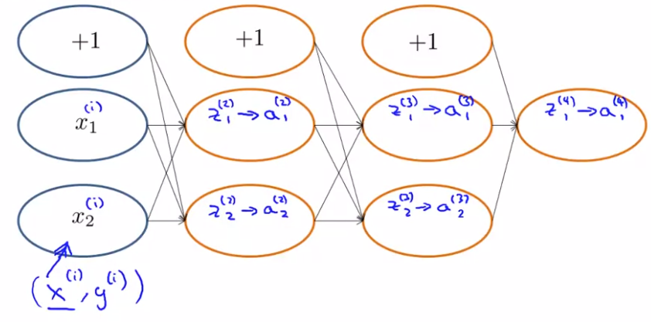
Backpropagation Intuition
Forward Propagation

Slide 18
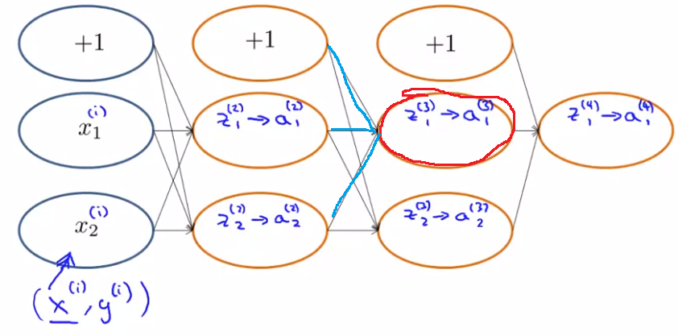
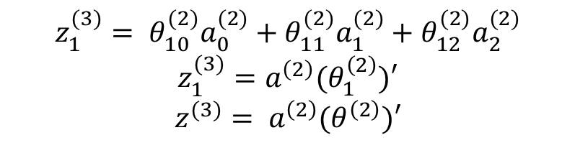
Backpropagation Intuition
Forward Propagation
$$z_{1}^{(3)}= θ_{10}^{(2)}a_{0}^{(2)}+θ_{11}^{(2)}a_{1}^{(2)}+θ_{12}^{(2)}a_{2}^{(2)}$$
$$z_{1}^{(3)}=a^{\left(2\right)}(θ_{1}^{\left(2\right)})′$$
$$z^{(3)}= a^{\left(2\right)}(θ^{\left(2\right)})′$$

Slide 19
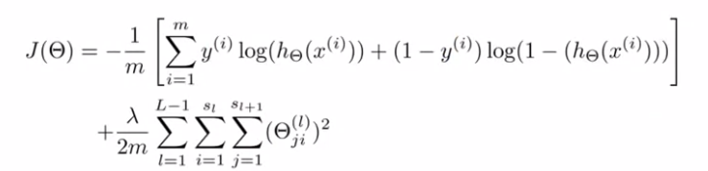


Backpropagation Intuition
Cost function
With single example $x^{(i)},y^{(i)}$, 1 output unit, $λ=0$

Slide 20
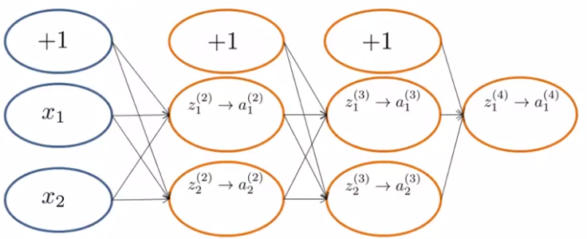
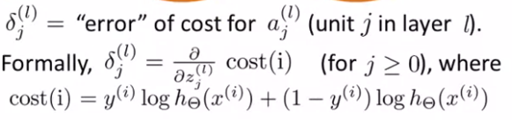
Backpropagation Intuition
Forward propagation

Slide 21
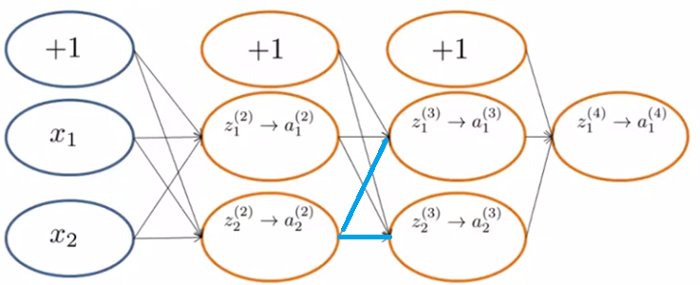


Backpropagation Intuition
Forward propagation
$$θ_{12}^{(2)}$$
$$θ_{22}^{(2)}$$

Slide 22






Backpropagation Intuition
Backward propagation
$$δ_{1}^{(3)}$$
$$θ_{12}^{(2)}$$
$$δ_{2}^{(2)}$$
$$θ_{22}^{(2)}$$
$$δ_{2}^{(3)}$$
$$δ_{2}^{(2)}=δ_{1}^{(3)}θ_{12}^{(2)}+δ_{2}^{(3)}θ_{22}^{(2)}$$

